Slide 2
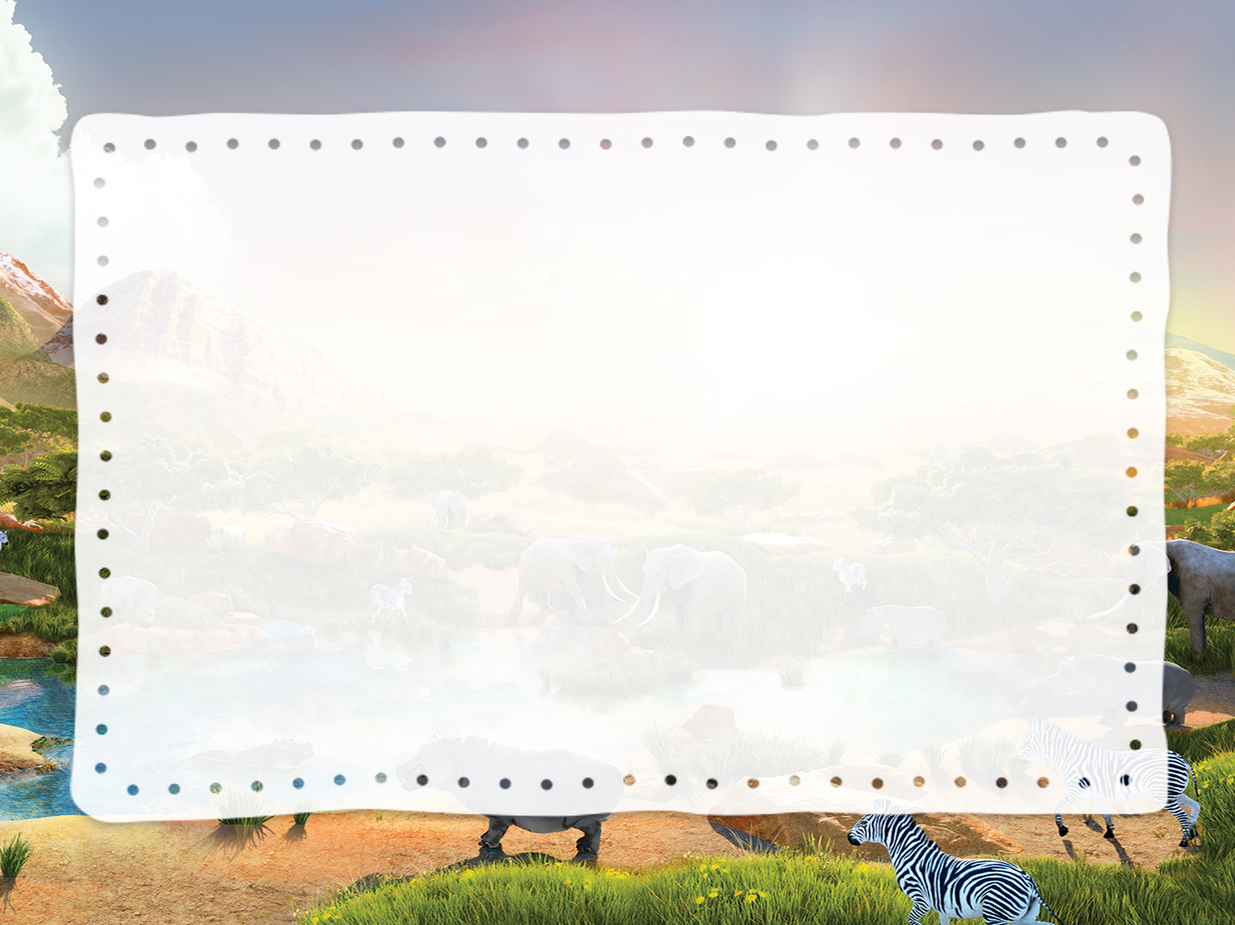
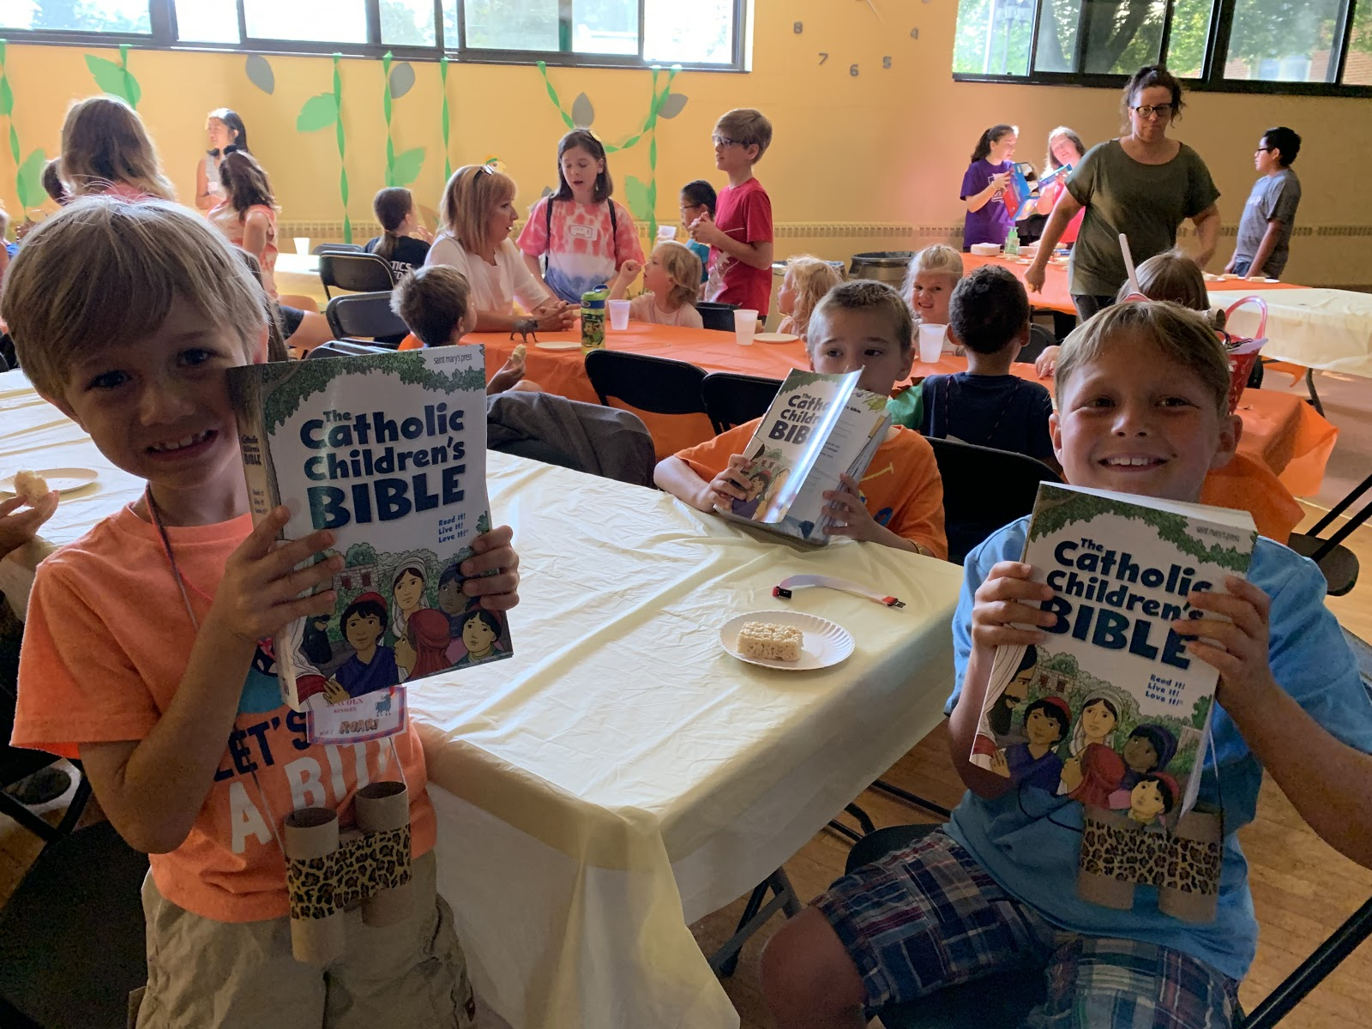
Several kids holding up Bibles**

Slide 3
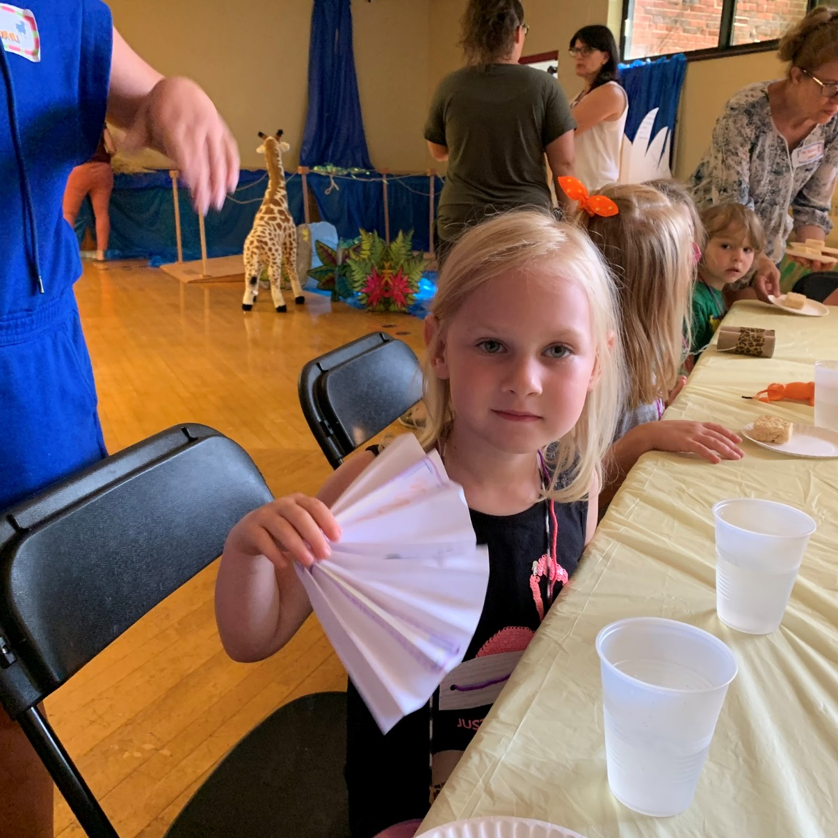
A few kids wiping their brows and fanning themselves, as if hot

Slide 4
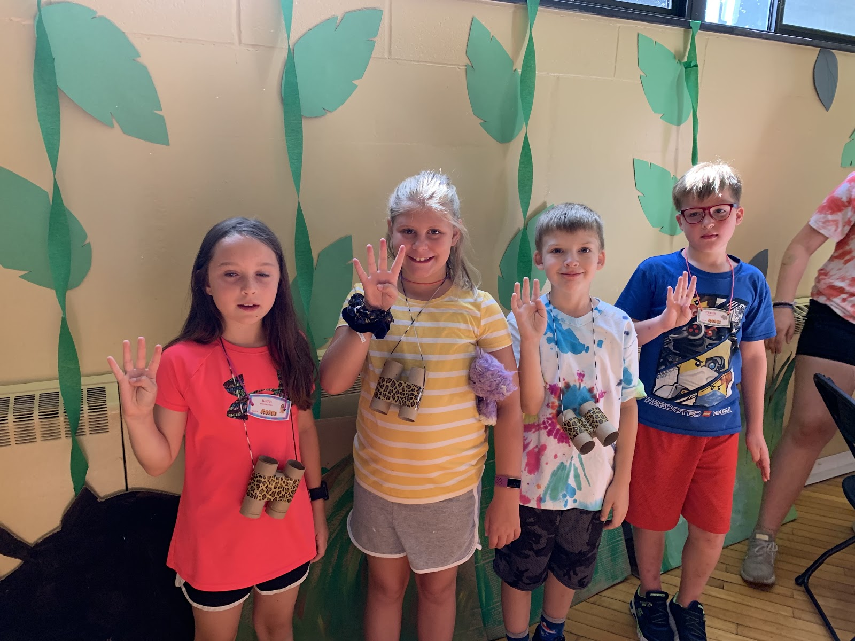
Four kids, each holding up four fingers

Slide 5
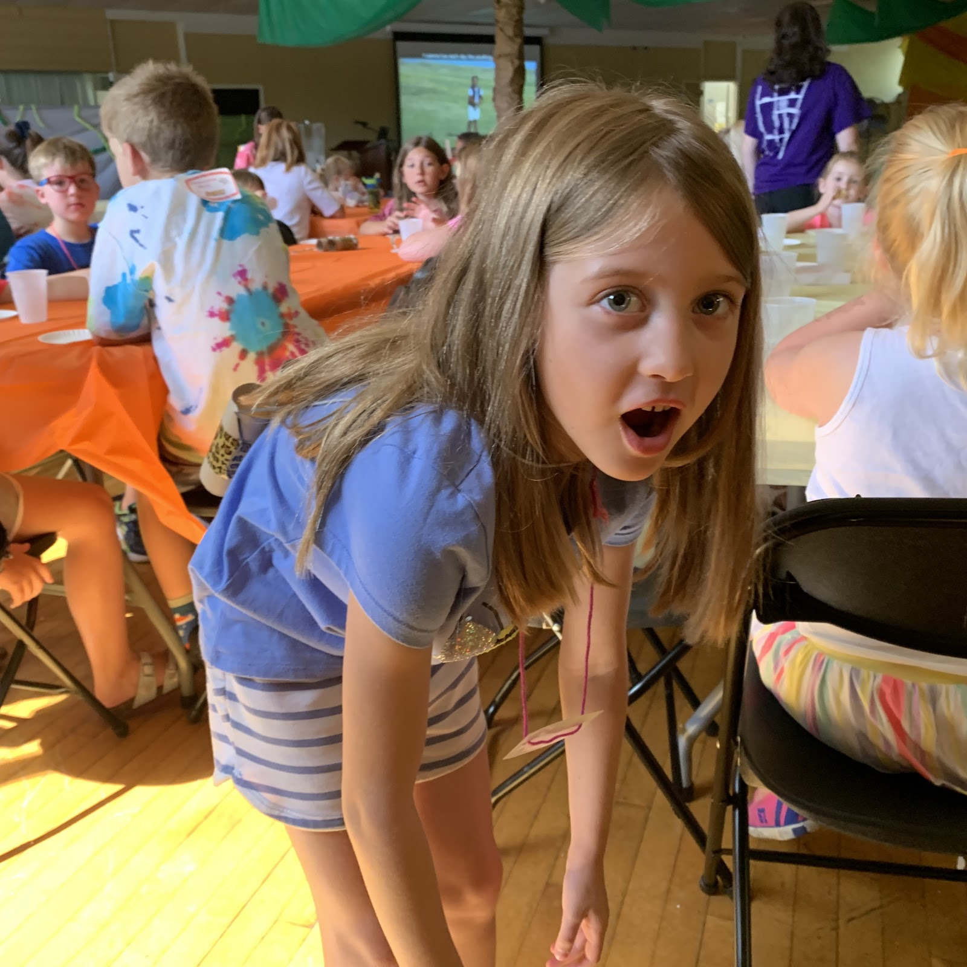
Kids using plastic shovels to fill buckets with yellow raffia**

Slide 6
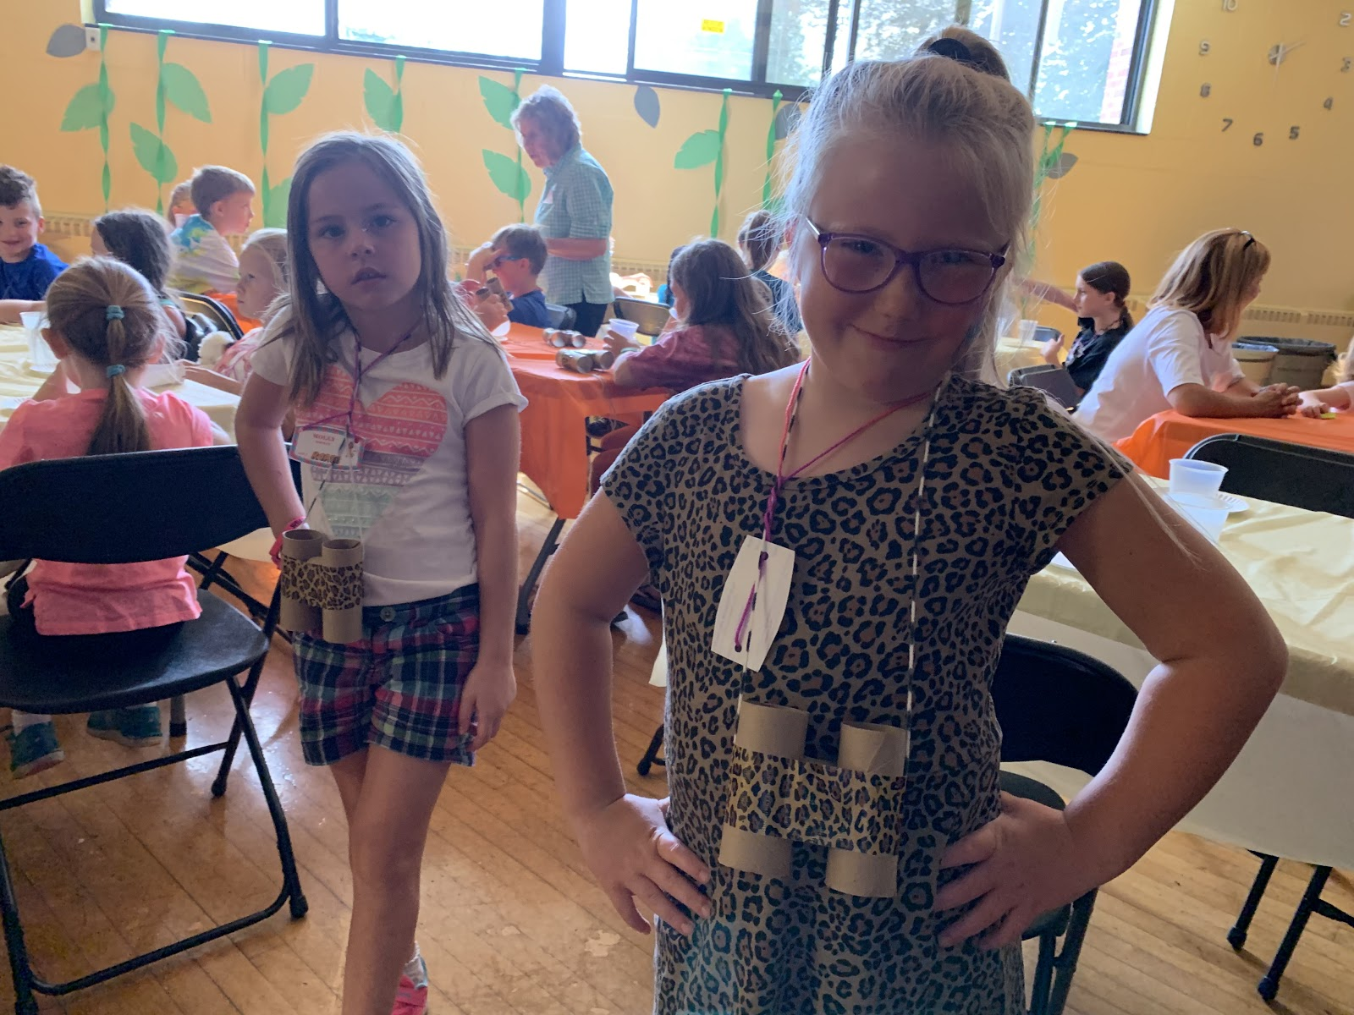
Several kids with hands on hips, looking stern

Slide 7
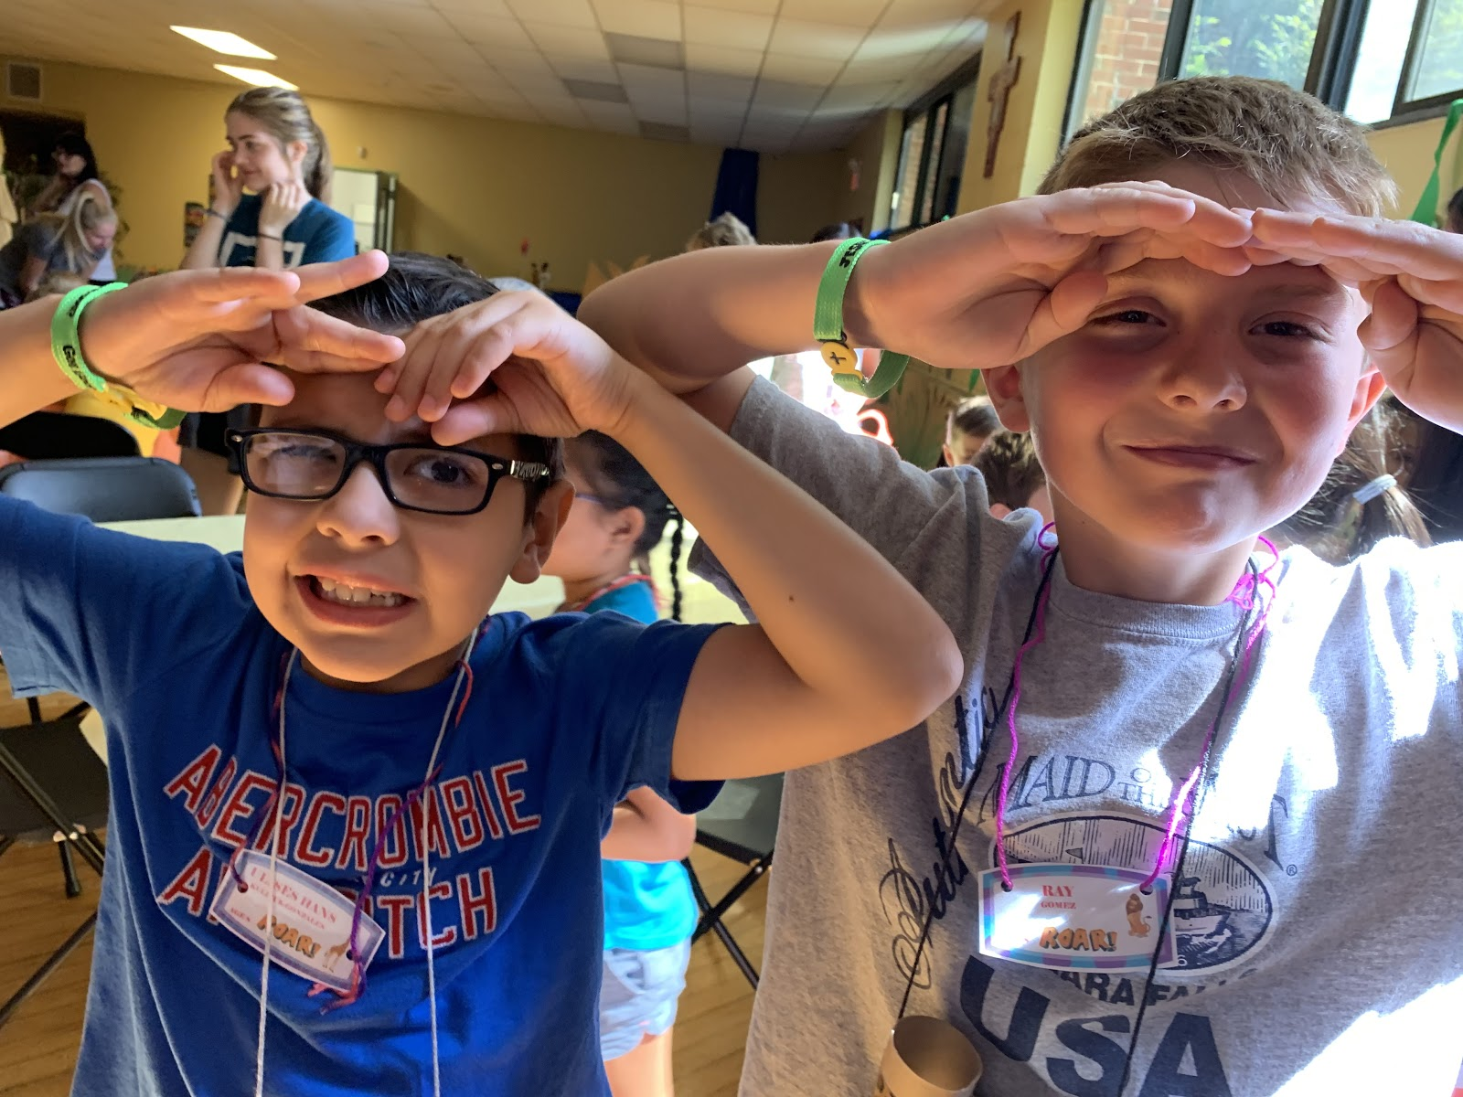
Kids wearing large sunglasses**

Slide 8
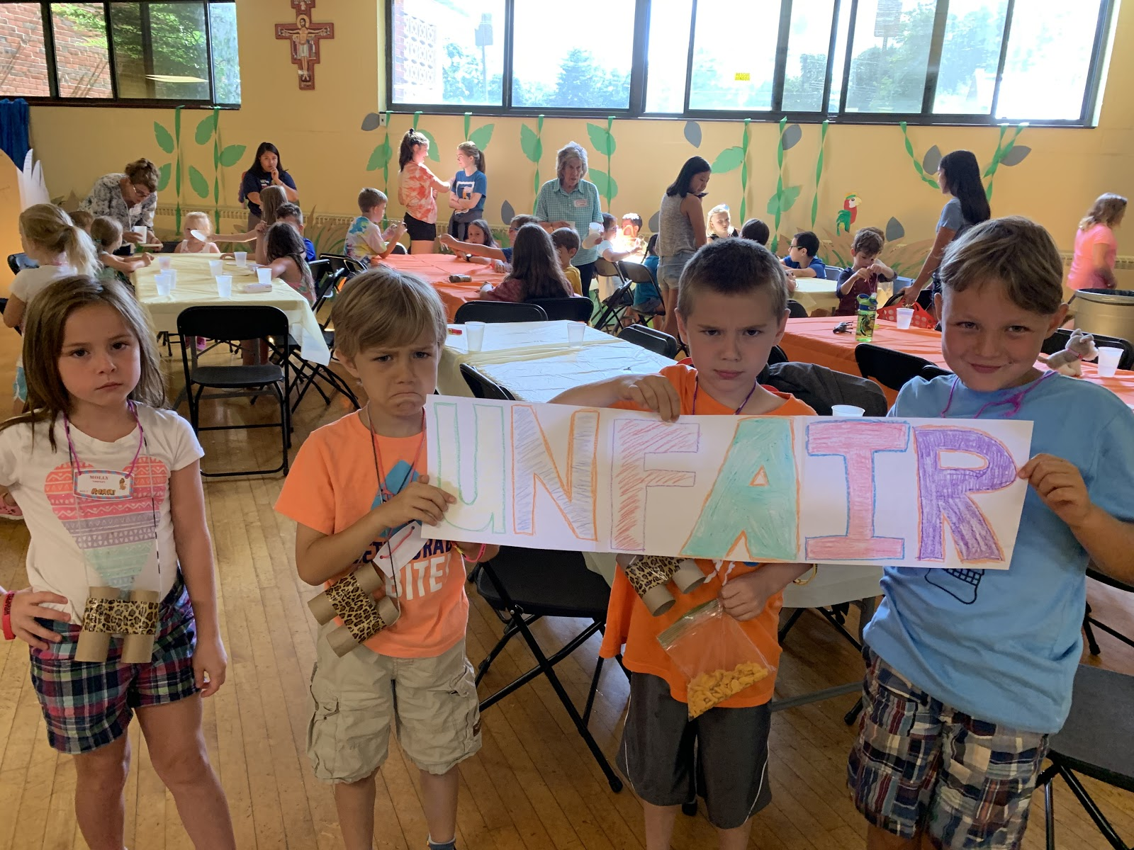
Kids holding signs that say ‘UNFAIR’**

Slide 9
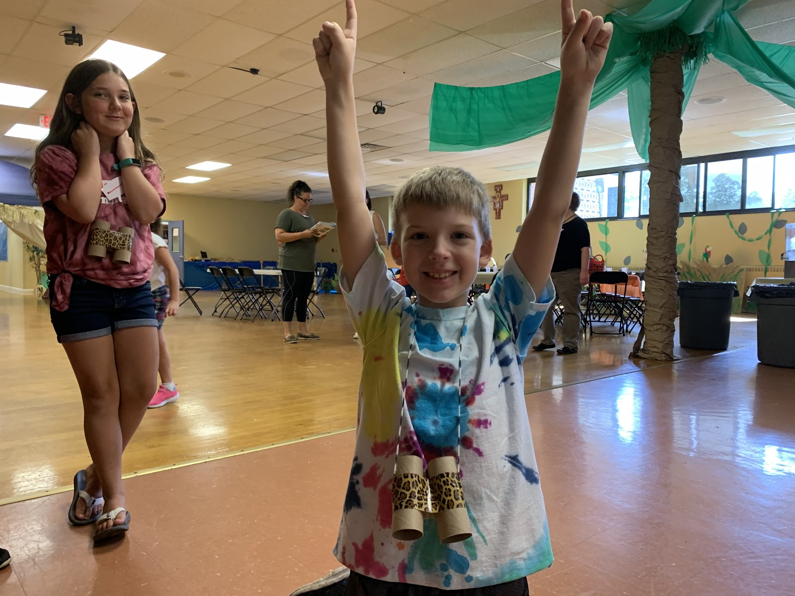
Smiling kids pointing to sky

Slide 10
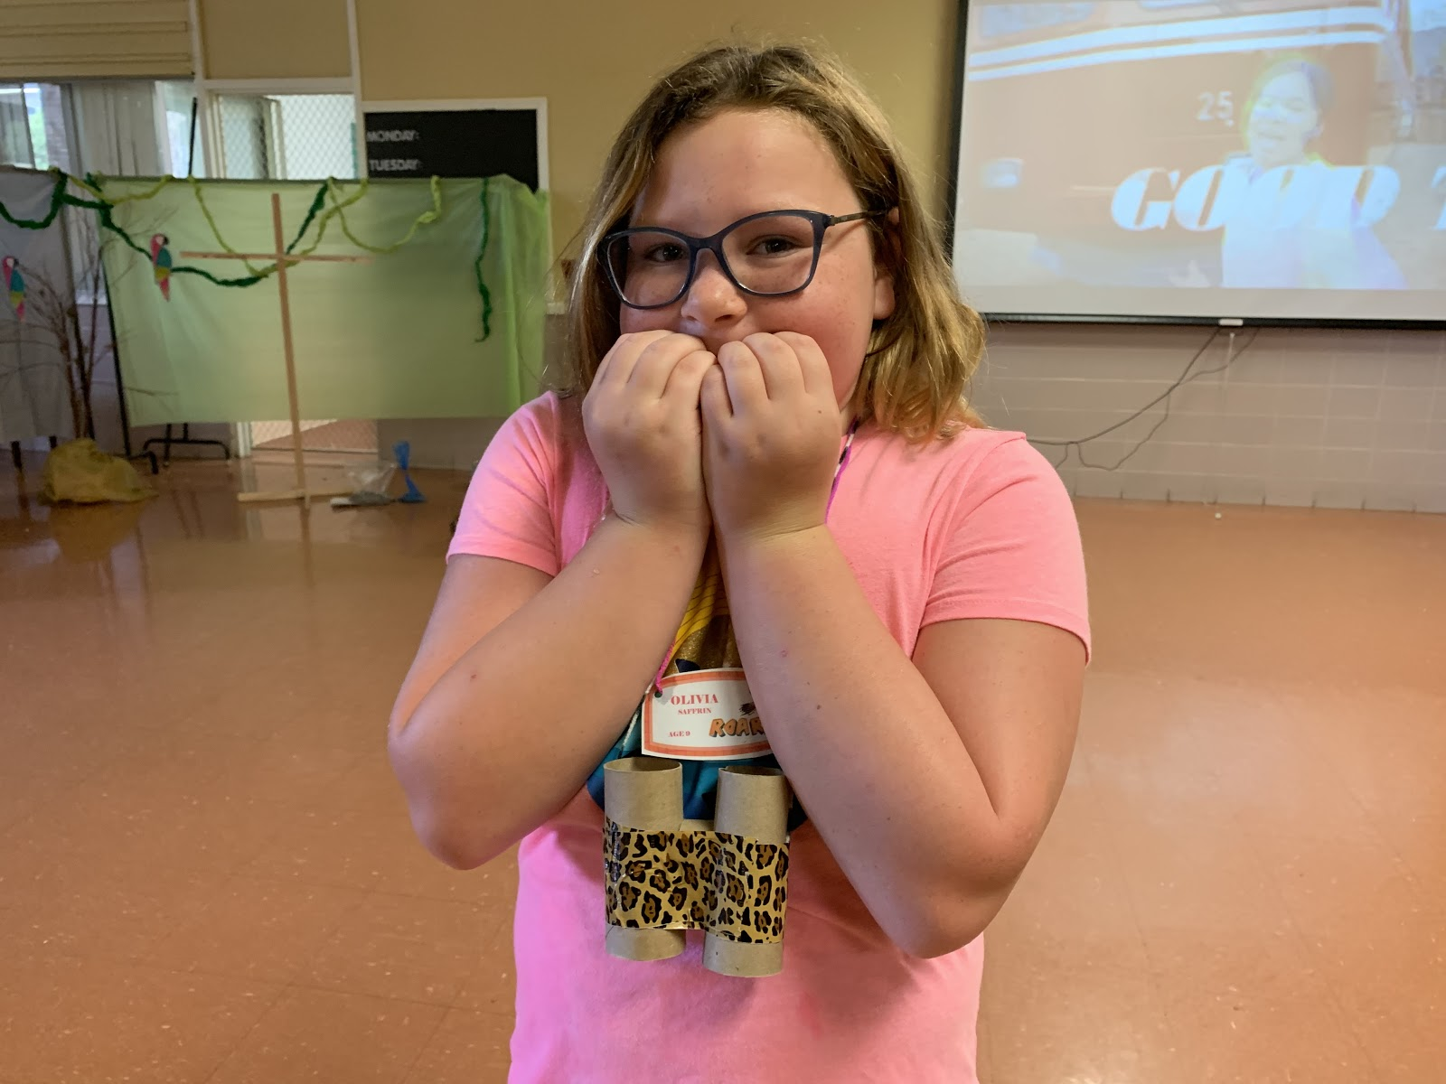
Boy pretending to chew his fingernails, looking scared

Slide 11
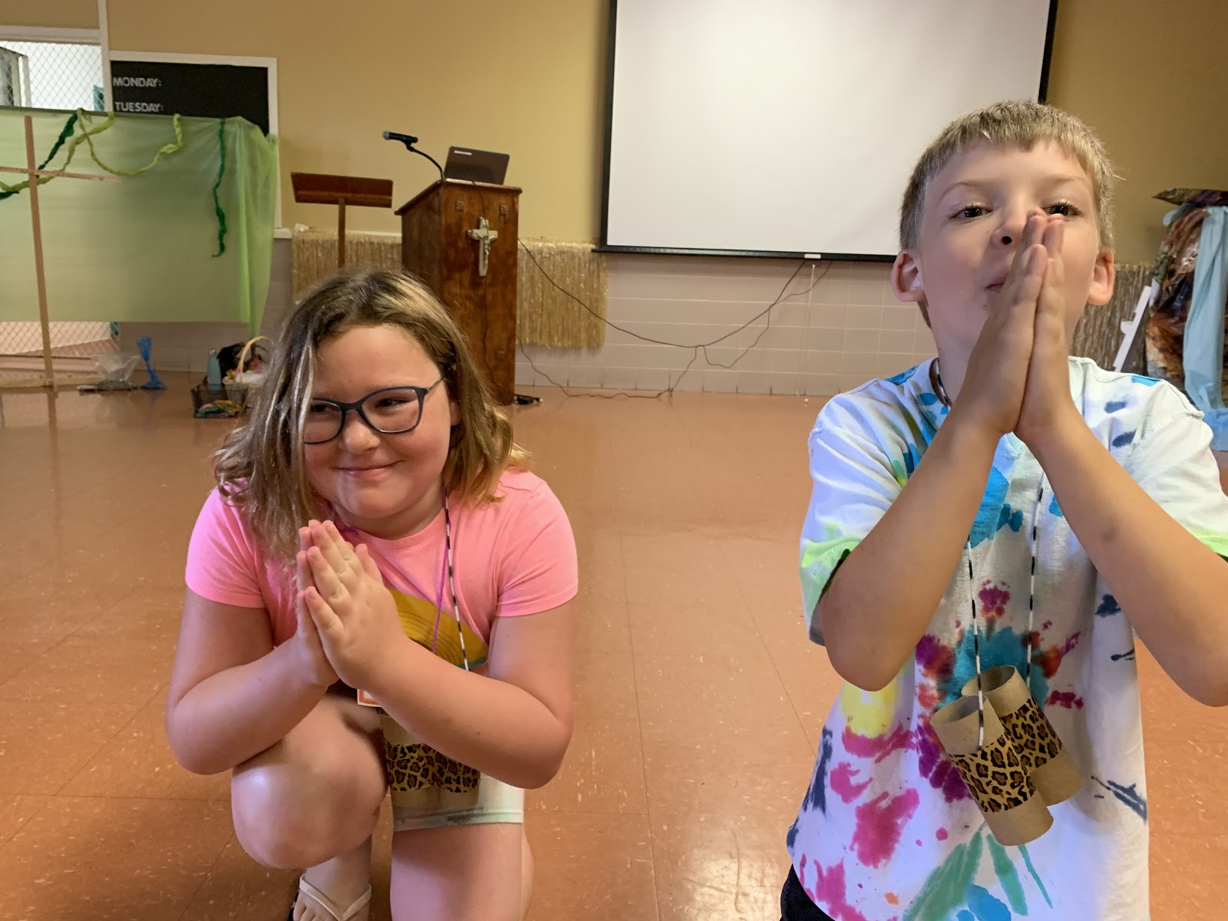
Same Moses boy kneeling with hands clasped, as
if pleading**

Slide 12
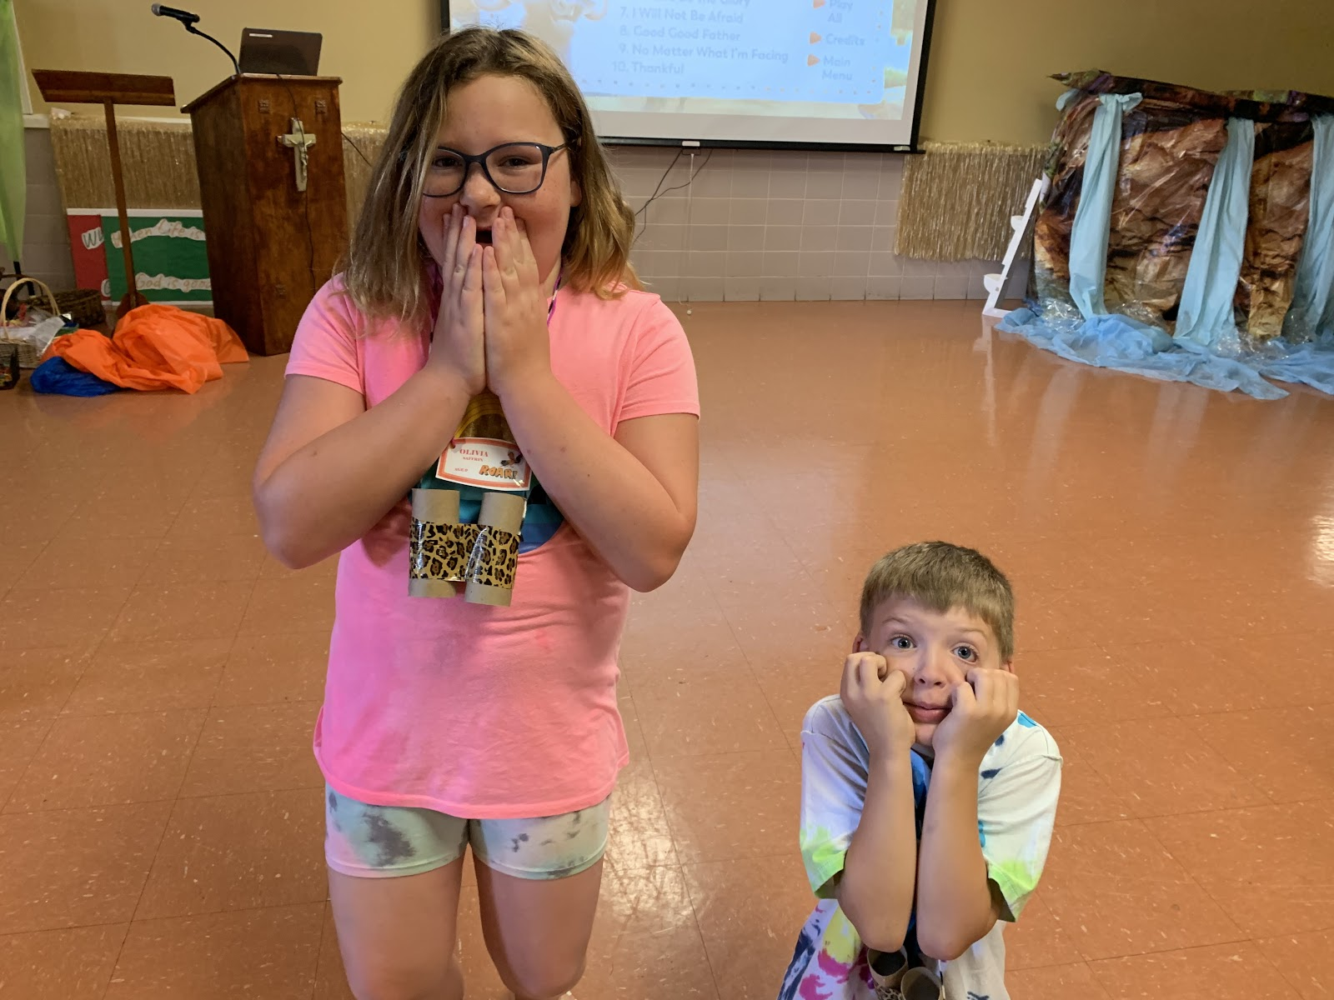
Moses boy and another boy (Aaron), both pretending to chew their nails, looking scared**

Slide 13
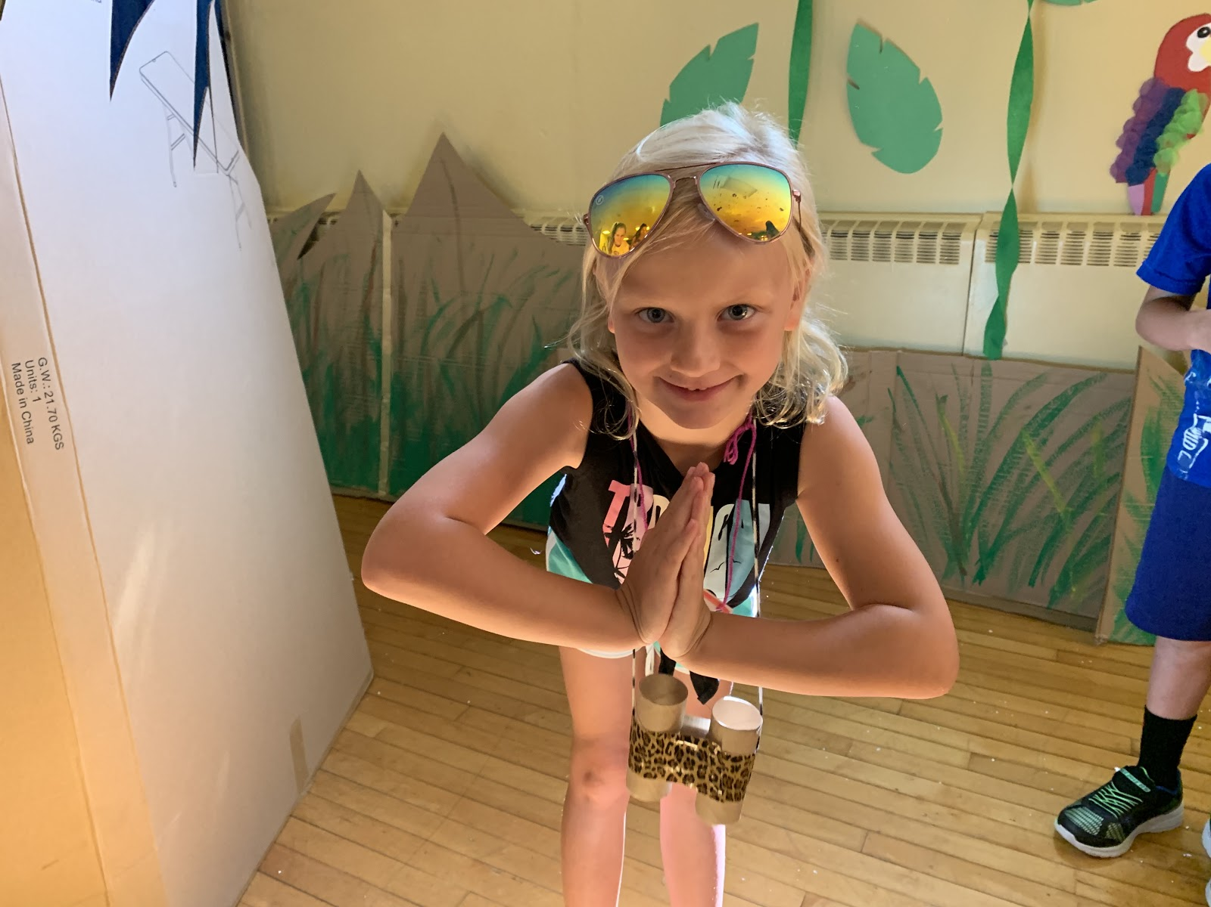
Kids on knees, bowing with arms stretched out and faces to the ground

Slide 14
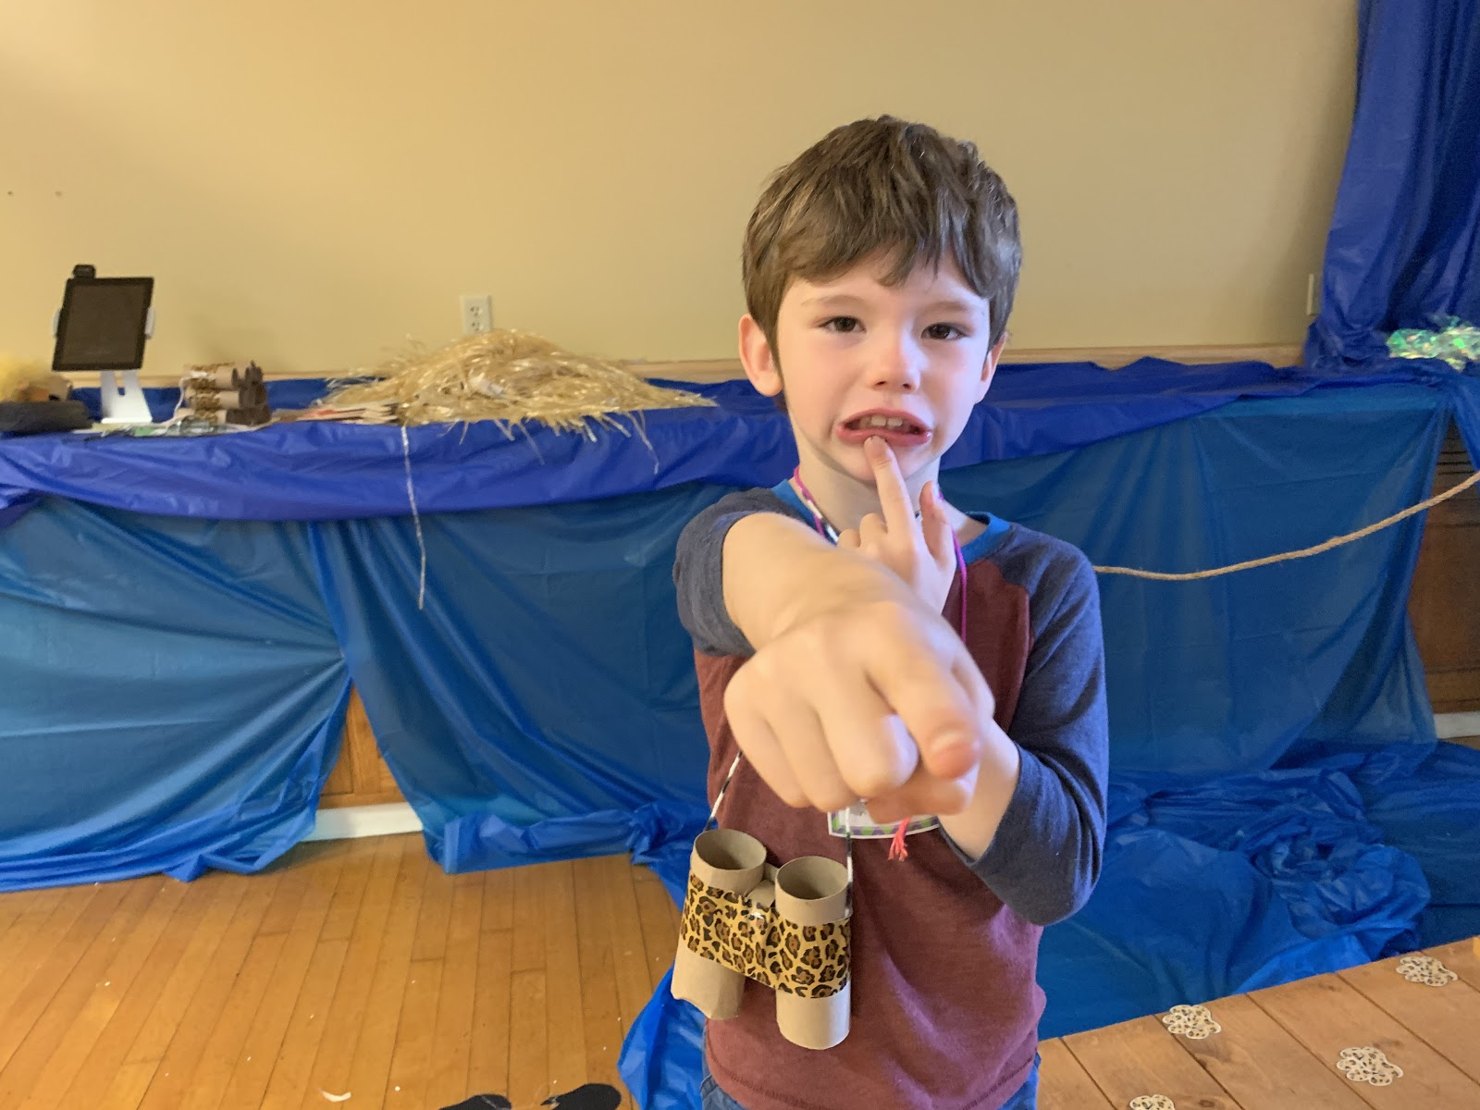
Different boy in Pharaoh attire, with arm stretched out and pointing,
looking angry**

Slide 15
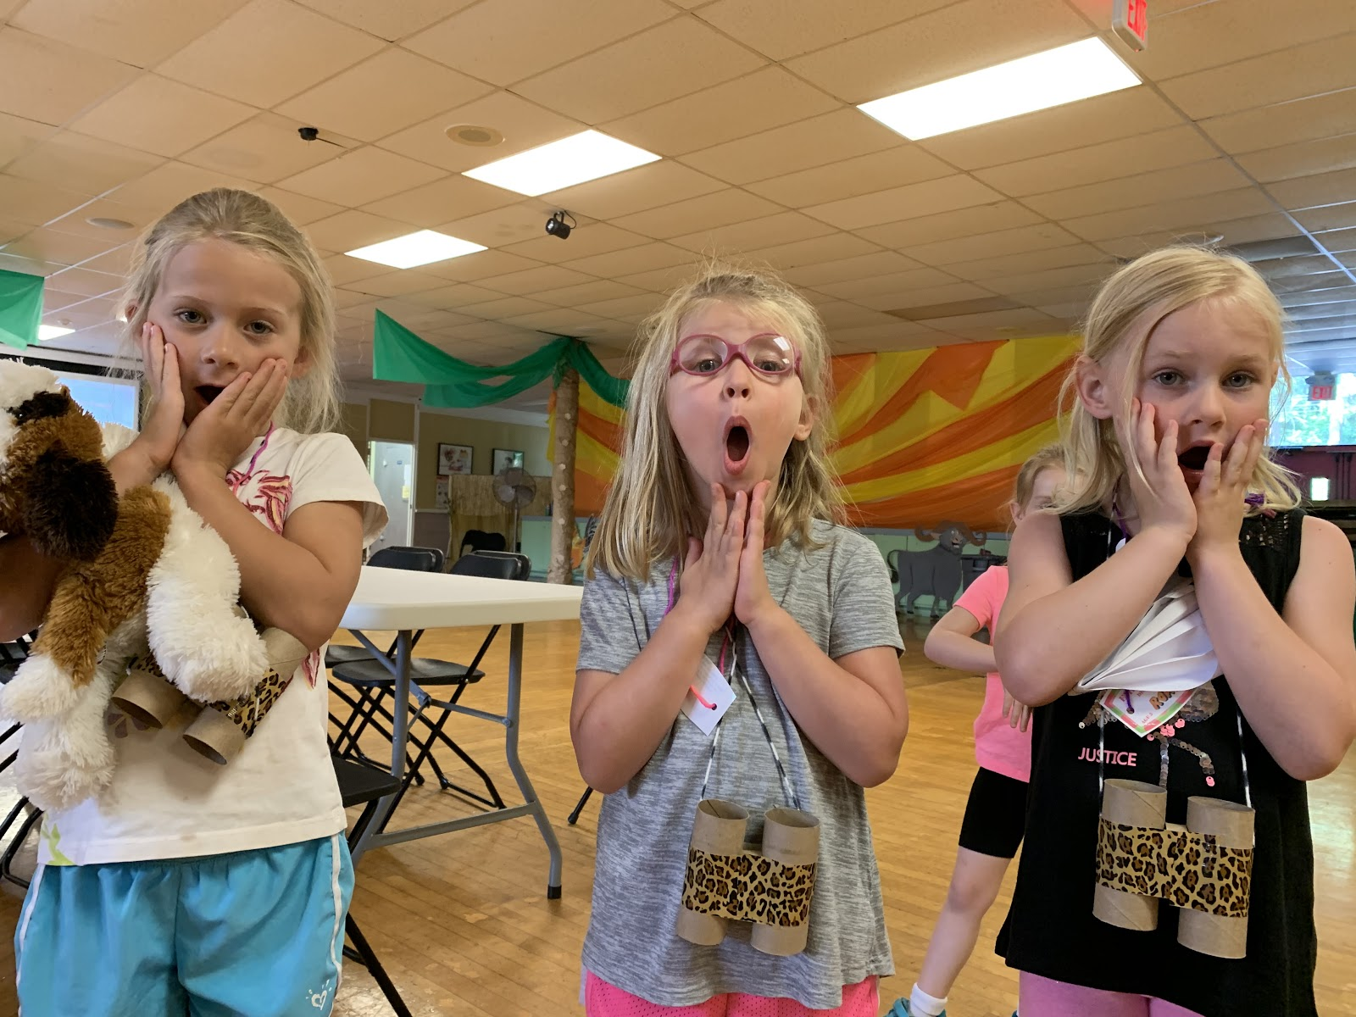
Kids looking surprised and upset

Slide 16
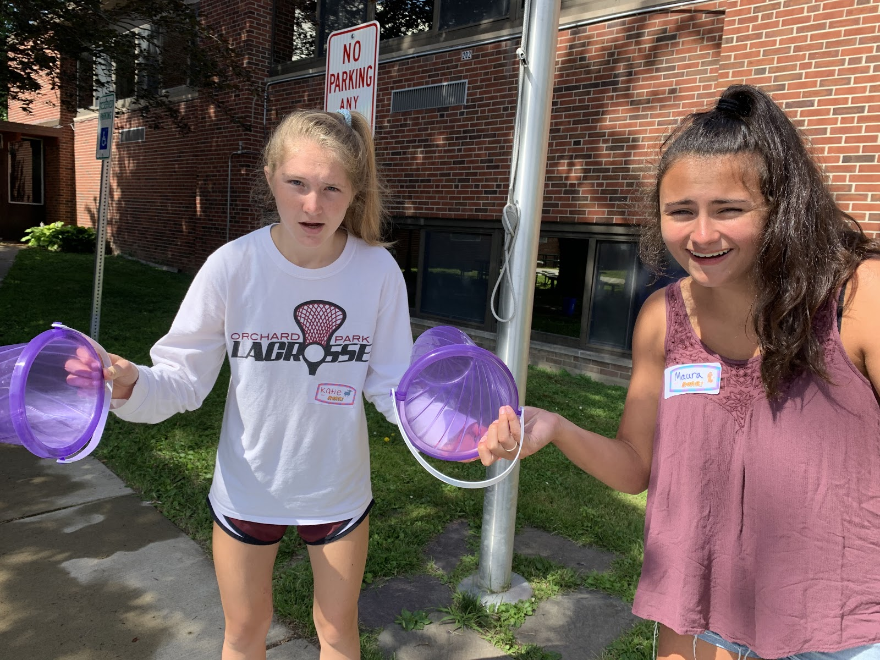
Kids looking very upset, holding overturned, empty buckets with no raffia in sight**

Slide 17
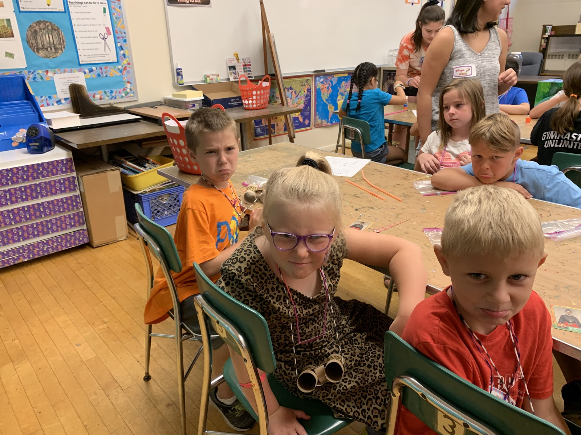
Upset kids on their knees, some with hands over their heads and some with arms stretched upward

Slide 18
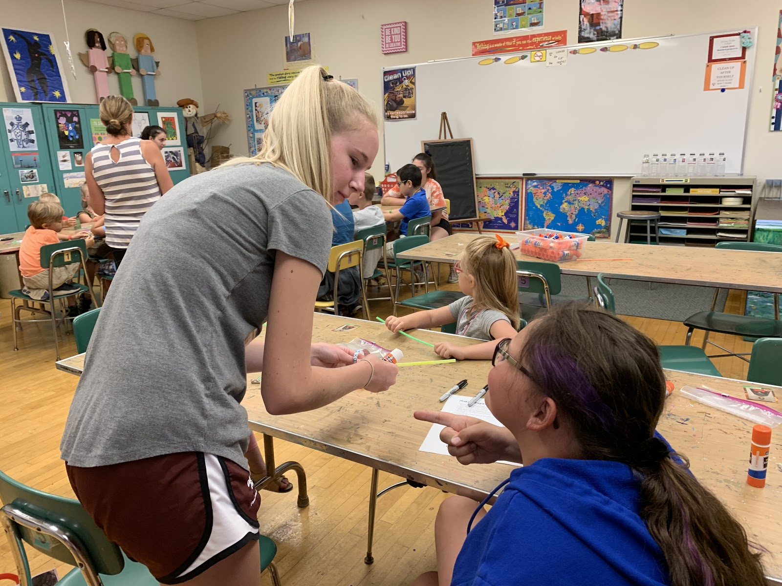
Moses and Aaron boys facing an angry crowd
of kids. Some kids in the crowd have their hands on their hips; others have fists in the air**

Slide 19
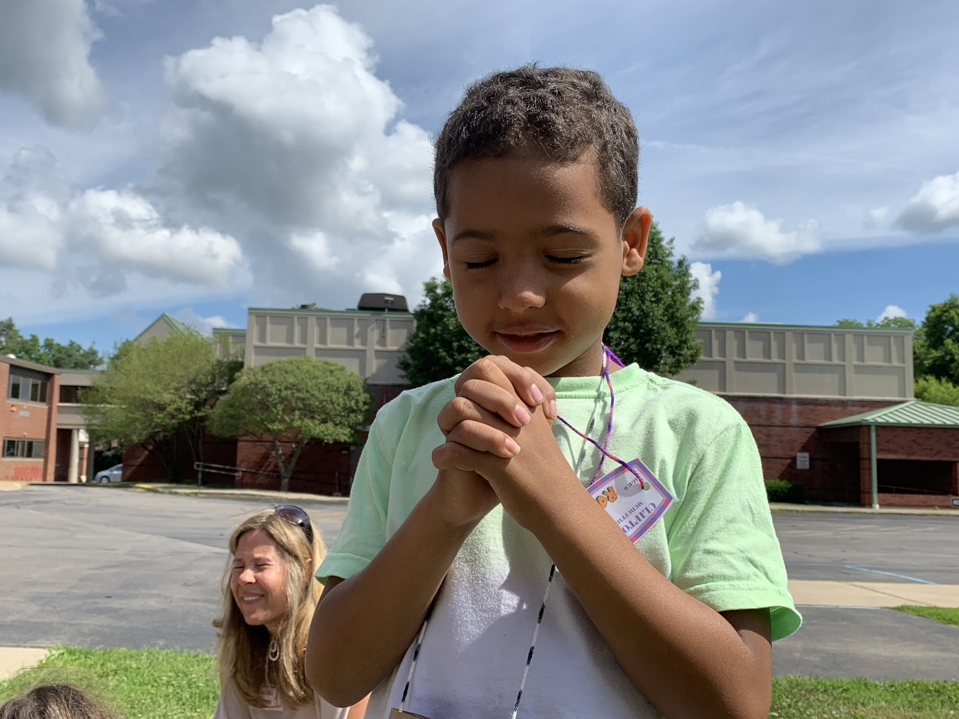
Moses boy on bended knee, with hands folded in prayer**

Slide 20
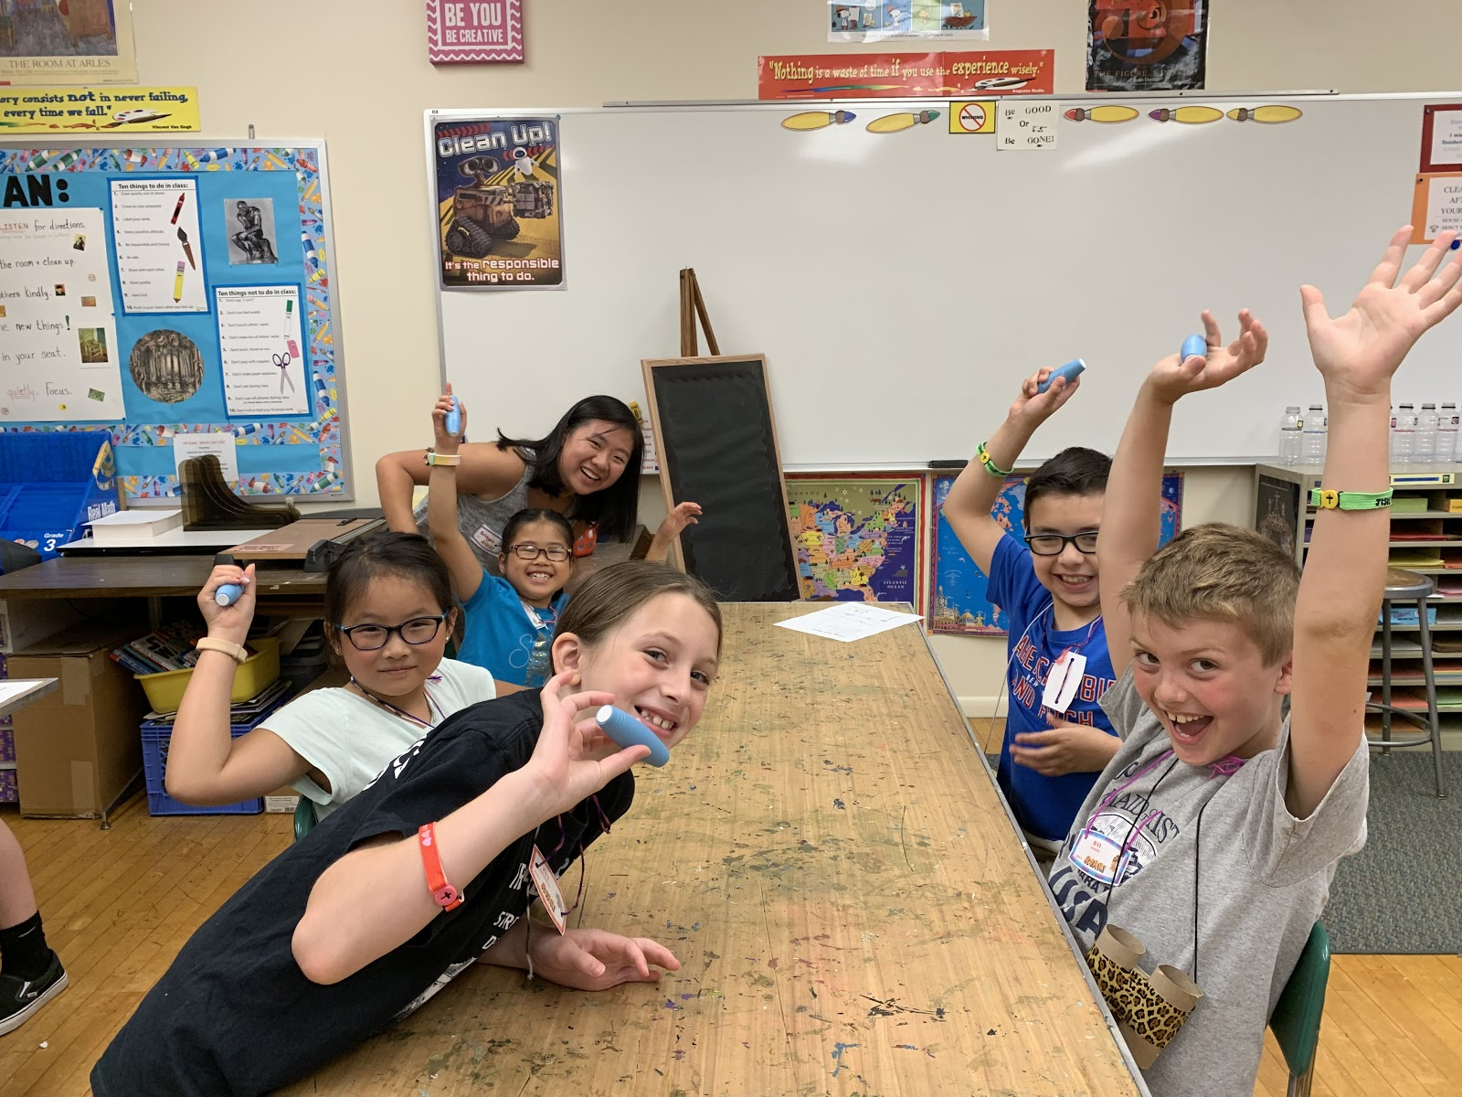
Happy kids cheering and clapping

Slide 21
